Slide 1


Team 13
Natural Language
Processing
Omar Aboelazm
Mohammed Assem

Slide 2

Table of
CONTENTS
01
02
03
04
Objective
Dataset EDA
NPT Classification
NPT Regression
05
06
07
08
PT Classification
PT Regression
Conclusion
Questions

Slide 3

OBJECTIVE
The objective of this project is to develop both classification and regression models that are capable of classifying text either it is related to IOS or Android and predicting scores based on the textual content of questions respectively. The dataset “ IOS vs Android ” dataset includes features such as the title, body, view count, and score of each question. Our goal is to use natural language processing (NLP) techniques and machine learning algorithms to accurately predict the class and score of a question based on its textual content. As mobile devices continue to shape various aspects of modern life, the ability to categorize and address user inquiries accurately holds immense practical value. Our project seeks to contribute to this endeavor by employing advanced NLP techniques to classify questions and build an effective question-answering system

Slide 4
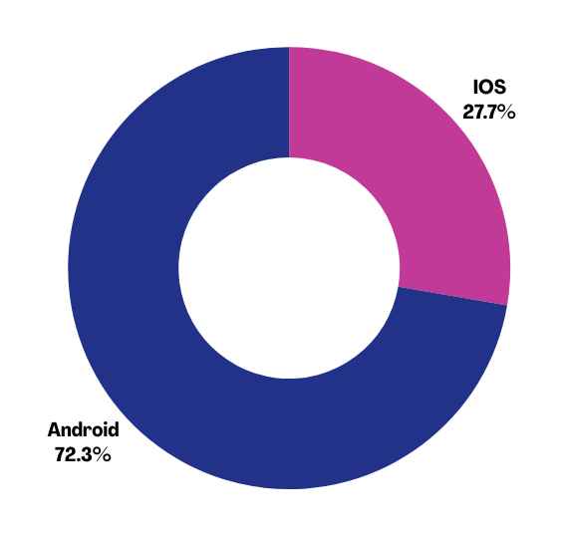

EDA and Data Preprocessing
551370 non null entries
outliers in the score column, which ranged from -21.0 to 489.0, using the Interquartile Range (IQR) method. This reduced the range to [-3, 5], resulting in a more balanced dataset.
Word Frequencies
Lowercasing
Tokenization using Bert
Removing Punctuation
Removing Stop Words
Stemming / Lemmatization
Joining Tokens

Slide 5

Classification Model
We opted for a Bidirectional Long Short-Term Memory (BiLSTM) network to capture long-range dependencies and sequential patterns in the textual data. Word embeddings were generated using the Word2Vec algorithm with a 300-dimensional embedding space. The model architecture included one Embedding layer, dynamic number of BiLSTM layers (default is 1) with 128 units and a dropout & recurrent dropout rate of 0.2 to prevent overfitting and a final dense layer with a sigmoid activation function.
BUILDING CUSTOM MODEL TO CLASSIFY TEXT

Slide 6
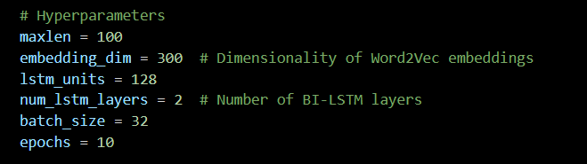
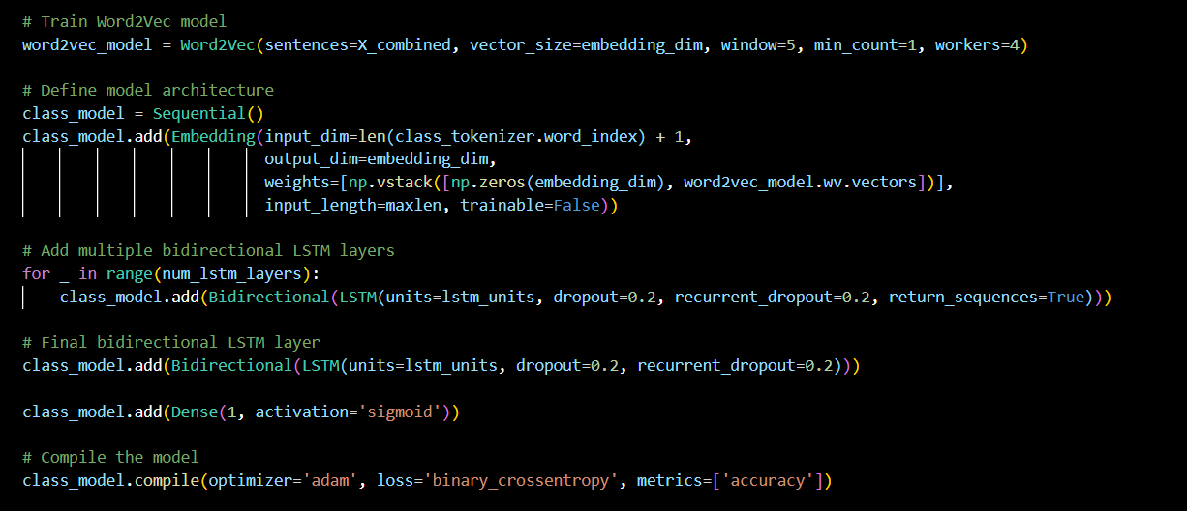
Classification Model
BUILDING CUSTOM MODEL TO CLASSIFY TEXT
Hyper-parameters
Model Architecture

Slide 7
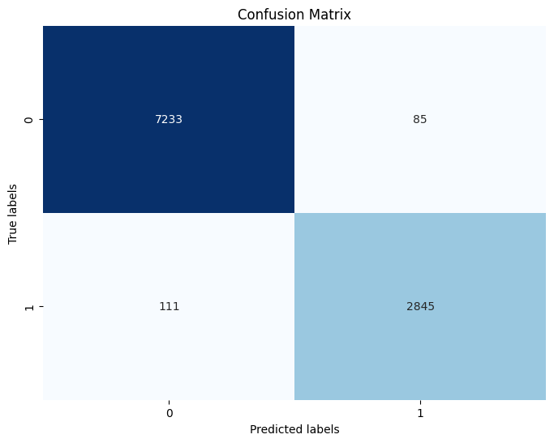
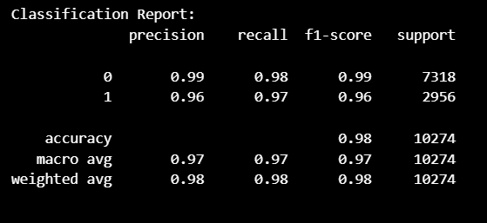
Classification Model
BUILDING CUSTOM MODEL TO CLASSIFY TEXT
Report
Confusion Matrix

Slide 8

Model Evaluation And Testing
Metric | Value
Accuracy | 98.1%
Precision | 97.1%
Recall | 96.2%
F1-Score | 96.6%

Slide 9
Regression Model
We opted for a Bidirectional Long Short-Term Memory (BiLSTM) network to capture long-range dependencies and sequential patterns in the textual data. Word embeddings were generated using the Word2Vec algorithm with a 100-dimensional embedding space. The model architecture included one LSTM layer with 64 units and a dropout rate of 0.2 to prevent overfitting.
BUILDING CUSTOM MODEL TO PREDICT THE SCORE

Slide 10
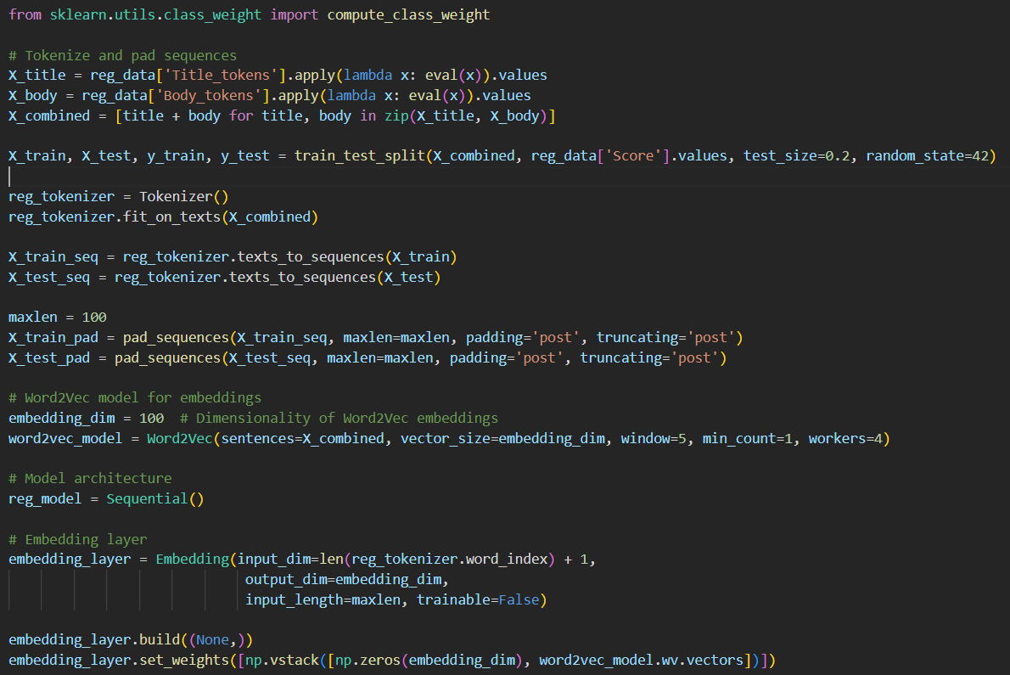
Regression Model
BUILDING CUSTOM MODEL TO PREDICT THE SCORE

Slide 11
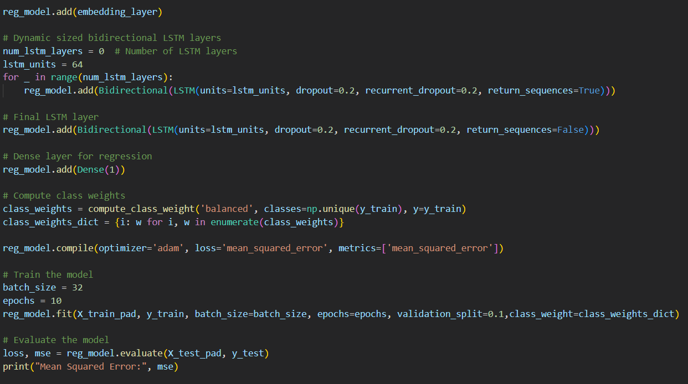
Regression Model
BUILDING CUSTOM MODEL TO PREDICT THE SCORE

Slide 12
Model Evaluation And Testing
Metric | Value
Mean Squared Error | 1.9077458381652832
Mean Absolute Error | 1.0839211270658935
Root Mean Squared Error | 1.3812117203683794
R-squared (R2 ) | 0.04285148909237679
The model was recreated using a loss function of Mean Absolute Error and it generated a MAE of 1.05

Slide 13
Classification Model
USING PRETRAINED MODEL TO CLASSIFY TEXT
TRANSFORMERS ARCHITECUTRE

Slide 14
Model Selection
01
BERT
02
RoBERTa
designed to reduce memory consumption and improve scalability. However, it often requires more training time and computational resources to achieve optimal performance.
An optimized version of BERT, RoBERTa excels in performance due to its extensive training on more data and modifications in training strategies. Despite its superior performance, it is computationally intensive.
03
DistilBERT
A distilled version of BERT, DistilBERT is designed to be smaller, faster, and lighter while retaining 97% of BERT’s performance while being 60% faster and smaller.. This balance of efficiency and effectiveness makes it an ideal choice for our regression task,

Slide 15

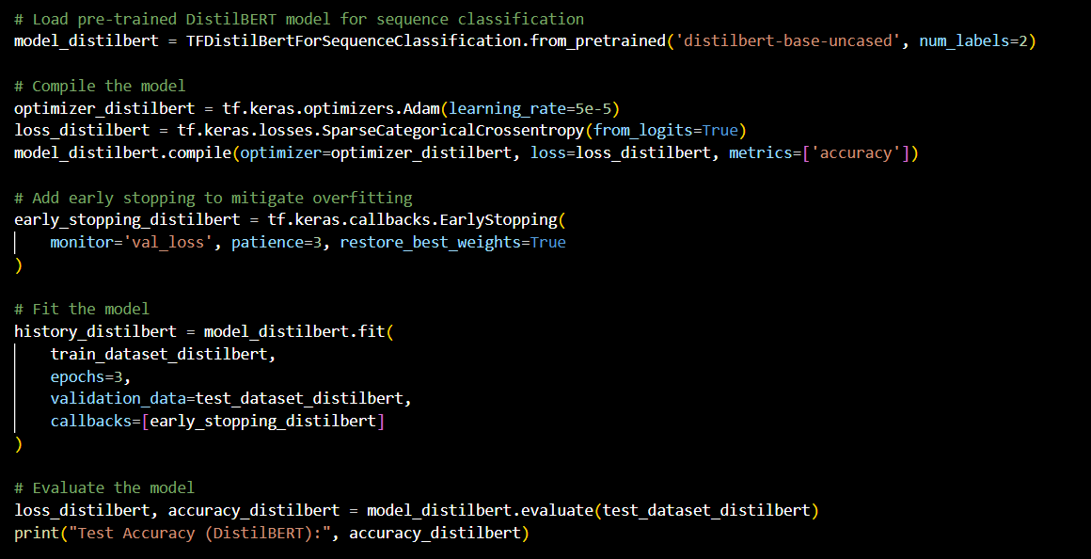
DISTILBERT
Transformer Architecture

Slide 16
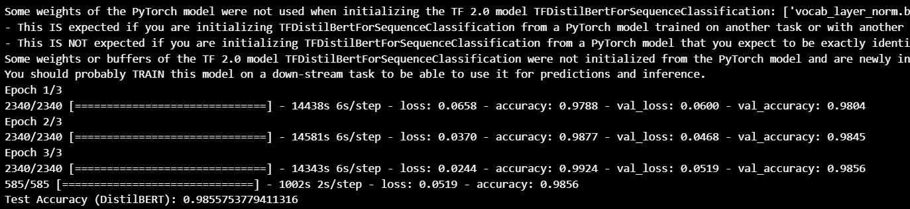
DISTILBERT
Transformer Architecture
Epochs = 3, Test Accuracy = 98.55%

Slide 17
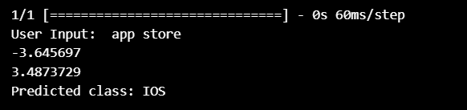
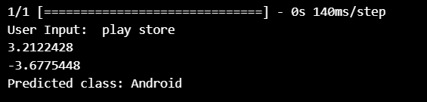
DISTILBERT
Transformer Architecture

Slide 18
ROBERT
Transformer Architecture

Slide 19
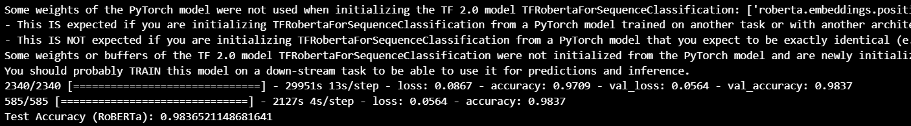
ROBERT
Transformer Architecture
Epochs = 1, Test Accuracy = 98.36%

Slide 20
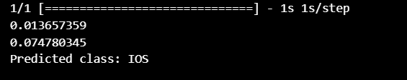
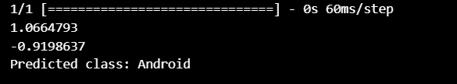
ROBERT
Transformer Architecture

Slide 21
Model Evaluation And Testing
Metric/Model | DistilBERT | RoBERT
Accuracy | 98.56% | 98.36

Slide 22
Regression Model
USING PRETRAINED MODEL TO PREDICT THE SCORE
TRANSFORMERS ARCHITECUTRE

Slide 23
Model Selection
01
ALBERT
02
RoBERTa
designed to reduce memory consumption and improve scalability. However, it often requires more training time and computational resources to achieve optimal performance.
An optimized version of BERT, RoBERTa excels in performance due to its extensive training on more data and modifications in training strategies. Despite its superior performance, it is computationally intensive.
03
XLNet
04
DistilBERT
This model outperforms many in capturing bidirectional context and achieving stateof-the-art results on various benchmarks. Its complexity and higher computational requirements, however, pose significant challenges.
A distilled version of BERT, DistilBERT is designed to be smaller, faster, and lighter while retaining 97% of BERT’s performance while being 60% faster and smaller.. This balance of efficiency and effectiveness makes it an ideal choice for our regression task,

Slide 24
DISTILBERT
Transformer Architecture
DistilBERT is a compact version of BERT, achieved through a technique called knowledge distillation. It reduces the number of layers from 12 (in BERT base) to 6, which significantly decreases model size and inference time.
The underlying architecture of DistilBERT is the transformer, which uses self-attention mechanisms to process sequences of text.
Input Embeddings
Self-Attention
Multi-Head Attention
Positional Encoding
Layer Normalization and Residual Connections

Slide 25
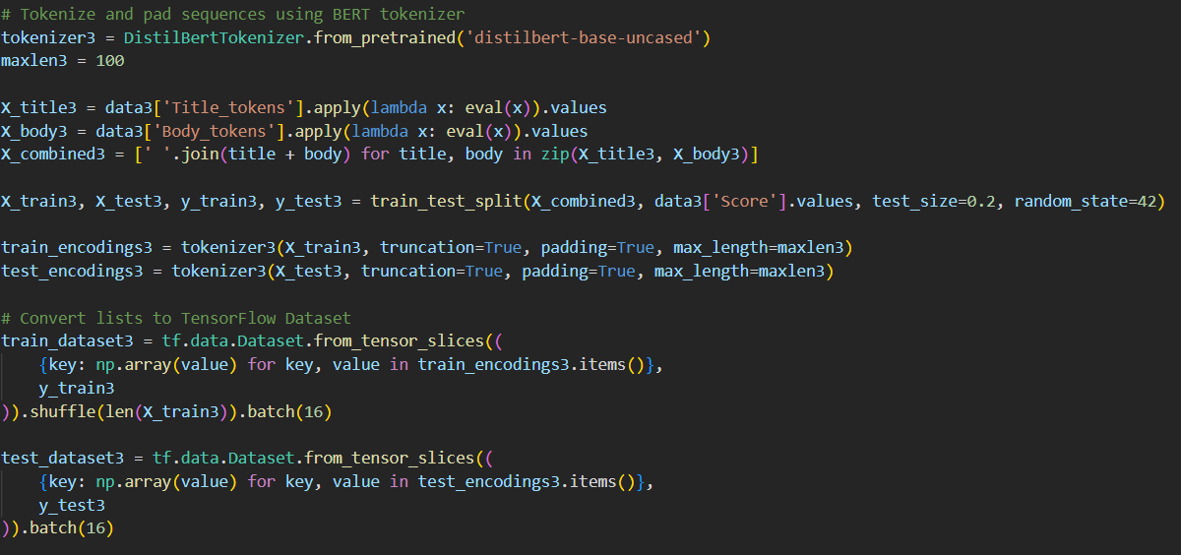
Regression Model
BUILDING PRETRAINED MODEL TO PREDICT THE SCORE

Slide 26
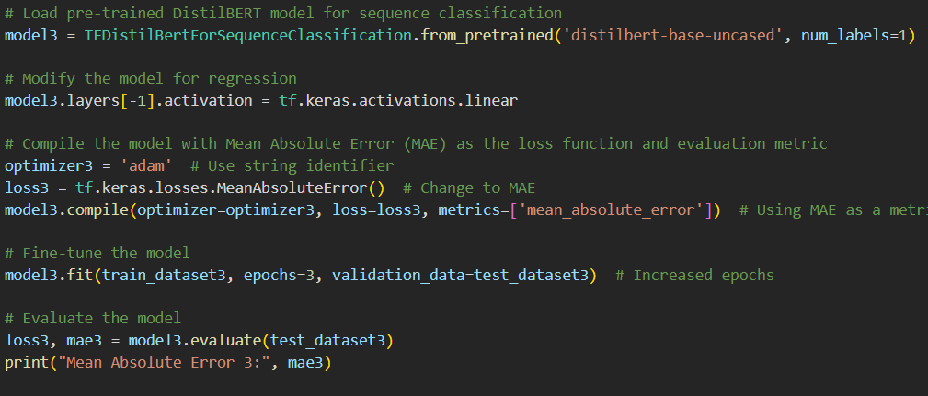
Regression Model
BUILDING PRETRAINED MODEL TO PREDICT THE SCORE
MEAN ABSOLUTE ERROR : 1.04

Slide 27
Conclusion
1 NPT Binary Classification Model
Accuracy 98.1%
1 NPT Regression Model
MAE = 1.05
2 PT Binary Classification Model
AVG. Accuracy 98.46%
4 PT Regression Models
Best MAE = 1.04

Slide 28
Team 13
THANK YOU
Omar Aboelazm 49-6765
Mohammed Assem 49-10901
Natural Language Processging

